Slide 1

Smart Kitchen using Gestures
Team: N One
Steven Han
Yewei Zhang
Yuanwei Zhang
Milestone 3

Slide 2


Statement of Problem
We want to help people improve their cooking by allowing them to simply follow along a recipe, and not have to deal with distractions like touchscreen or voice commands.

Slide 3
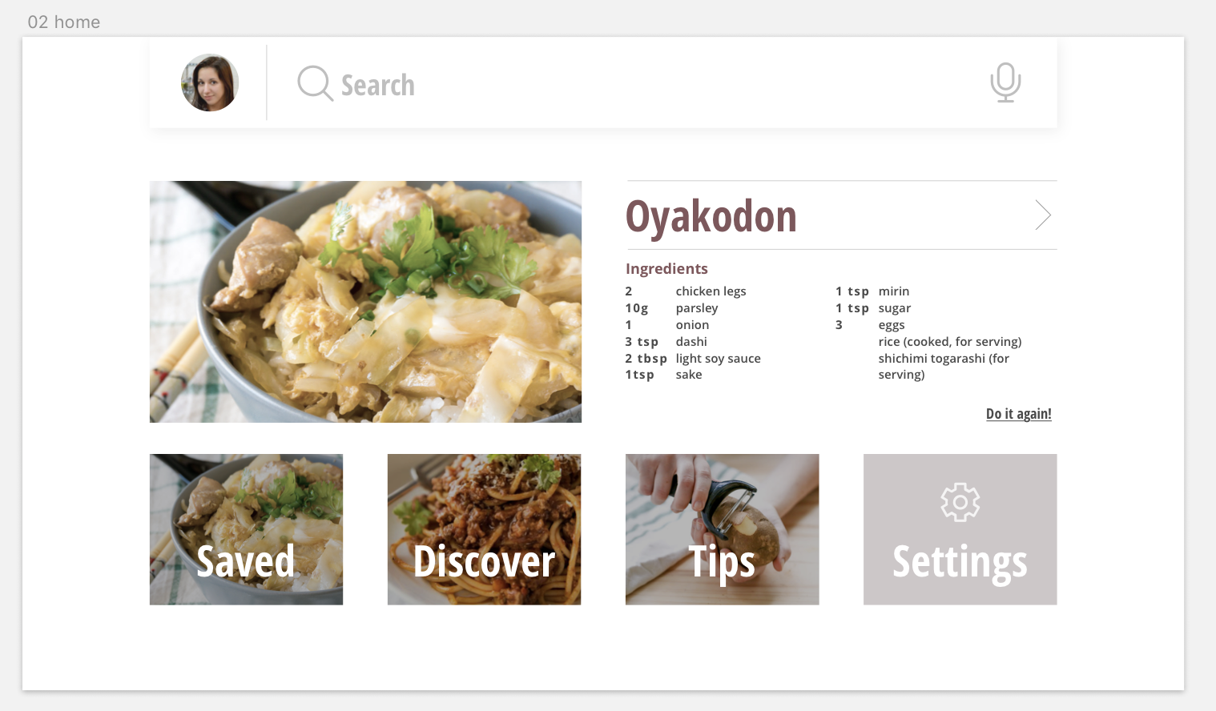
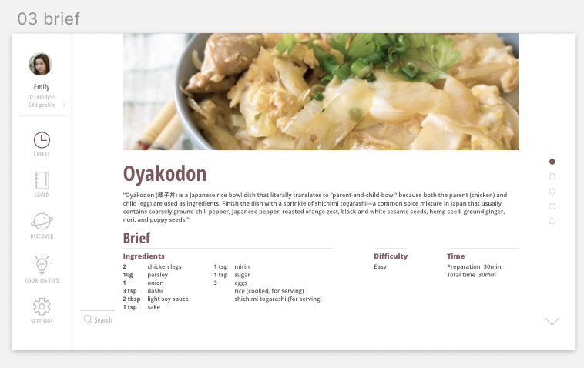
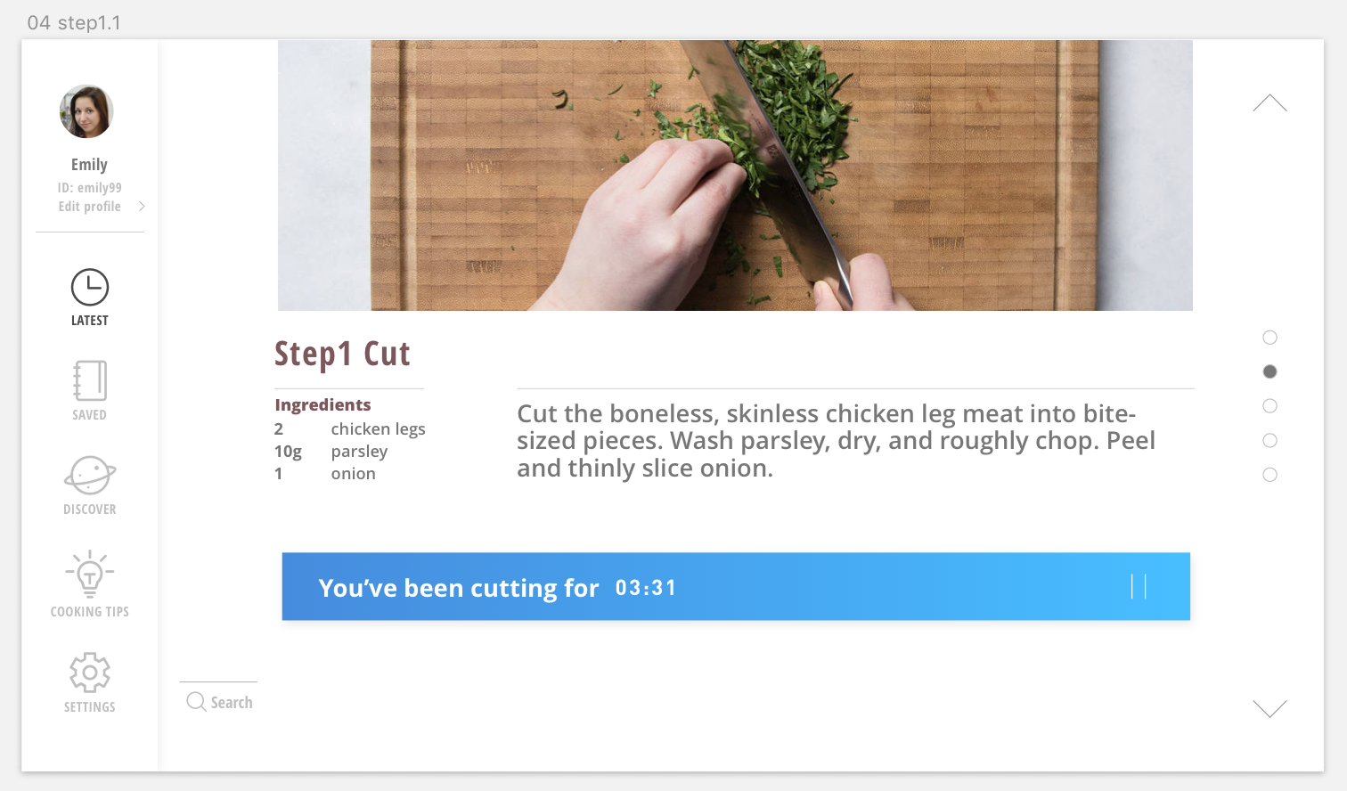
Design Changes
Changed Android App to website in order to more easily display the visual interface we want to use.
Instead of using a fixed dataset where we create a pre-trained model, we decided to create a dynamic dataset that each new user can add onto pre-existing data.
New users input their training data onto our model through a quick and easy setup so we can create a more customized model for that specific user and therefore have a higher accuracy detecting their motions.

Slide 4
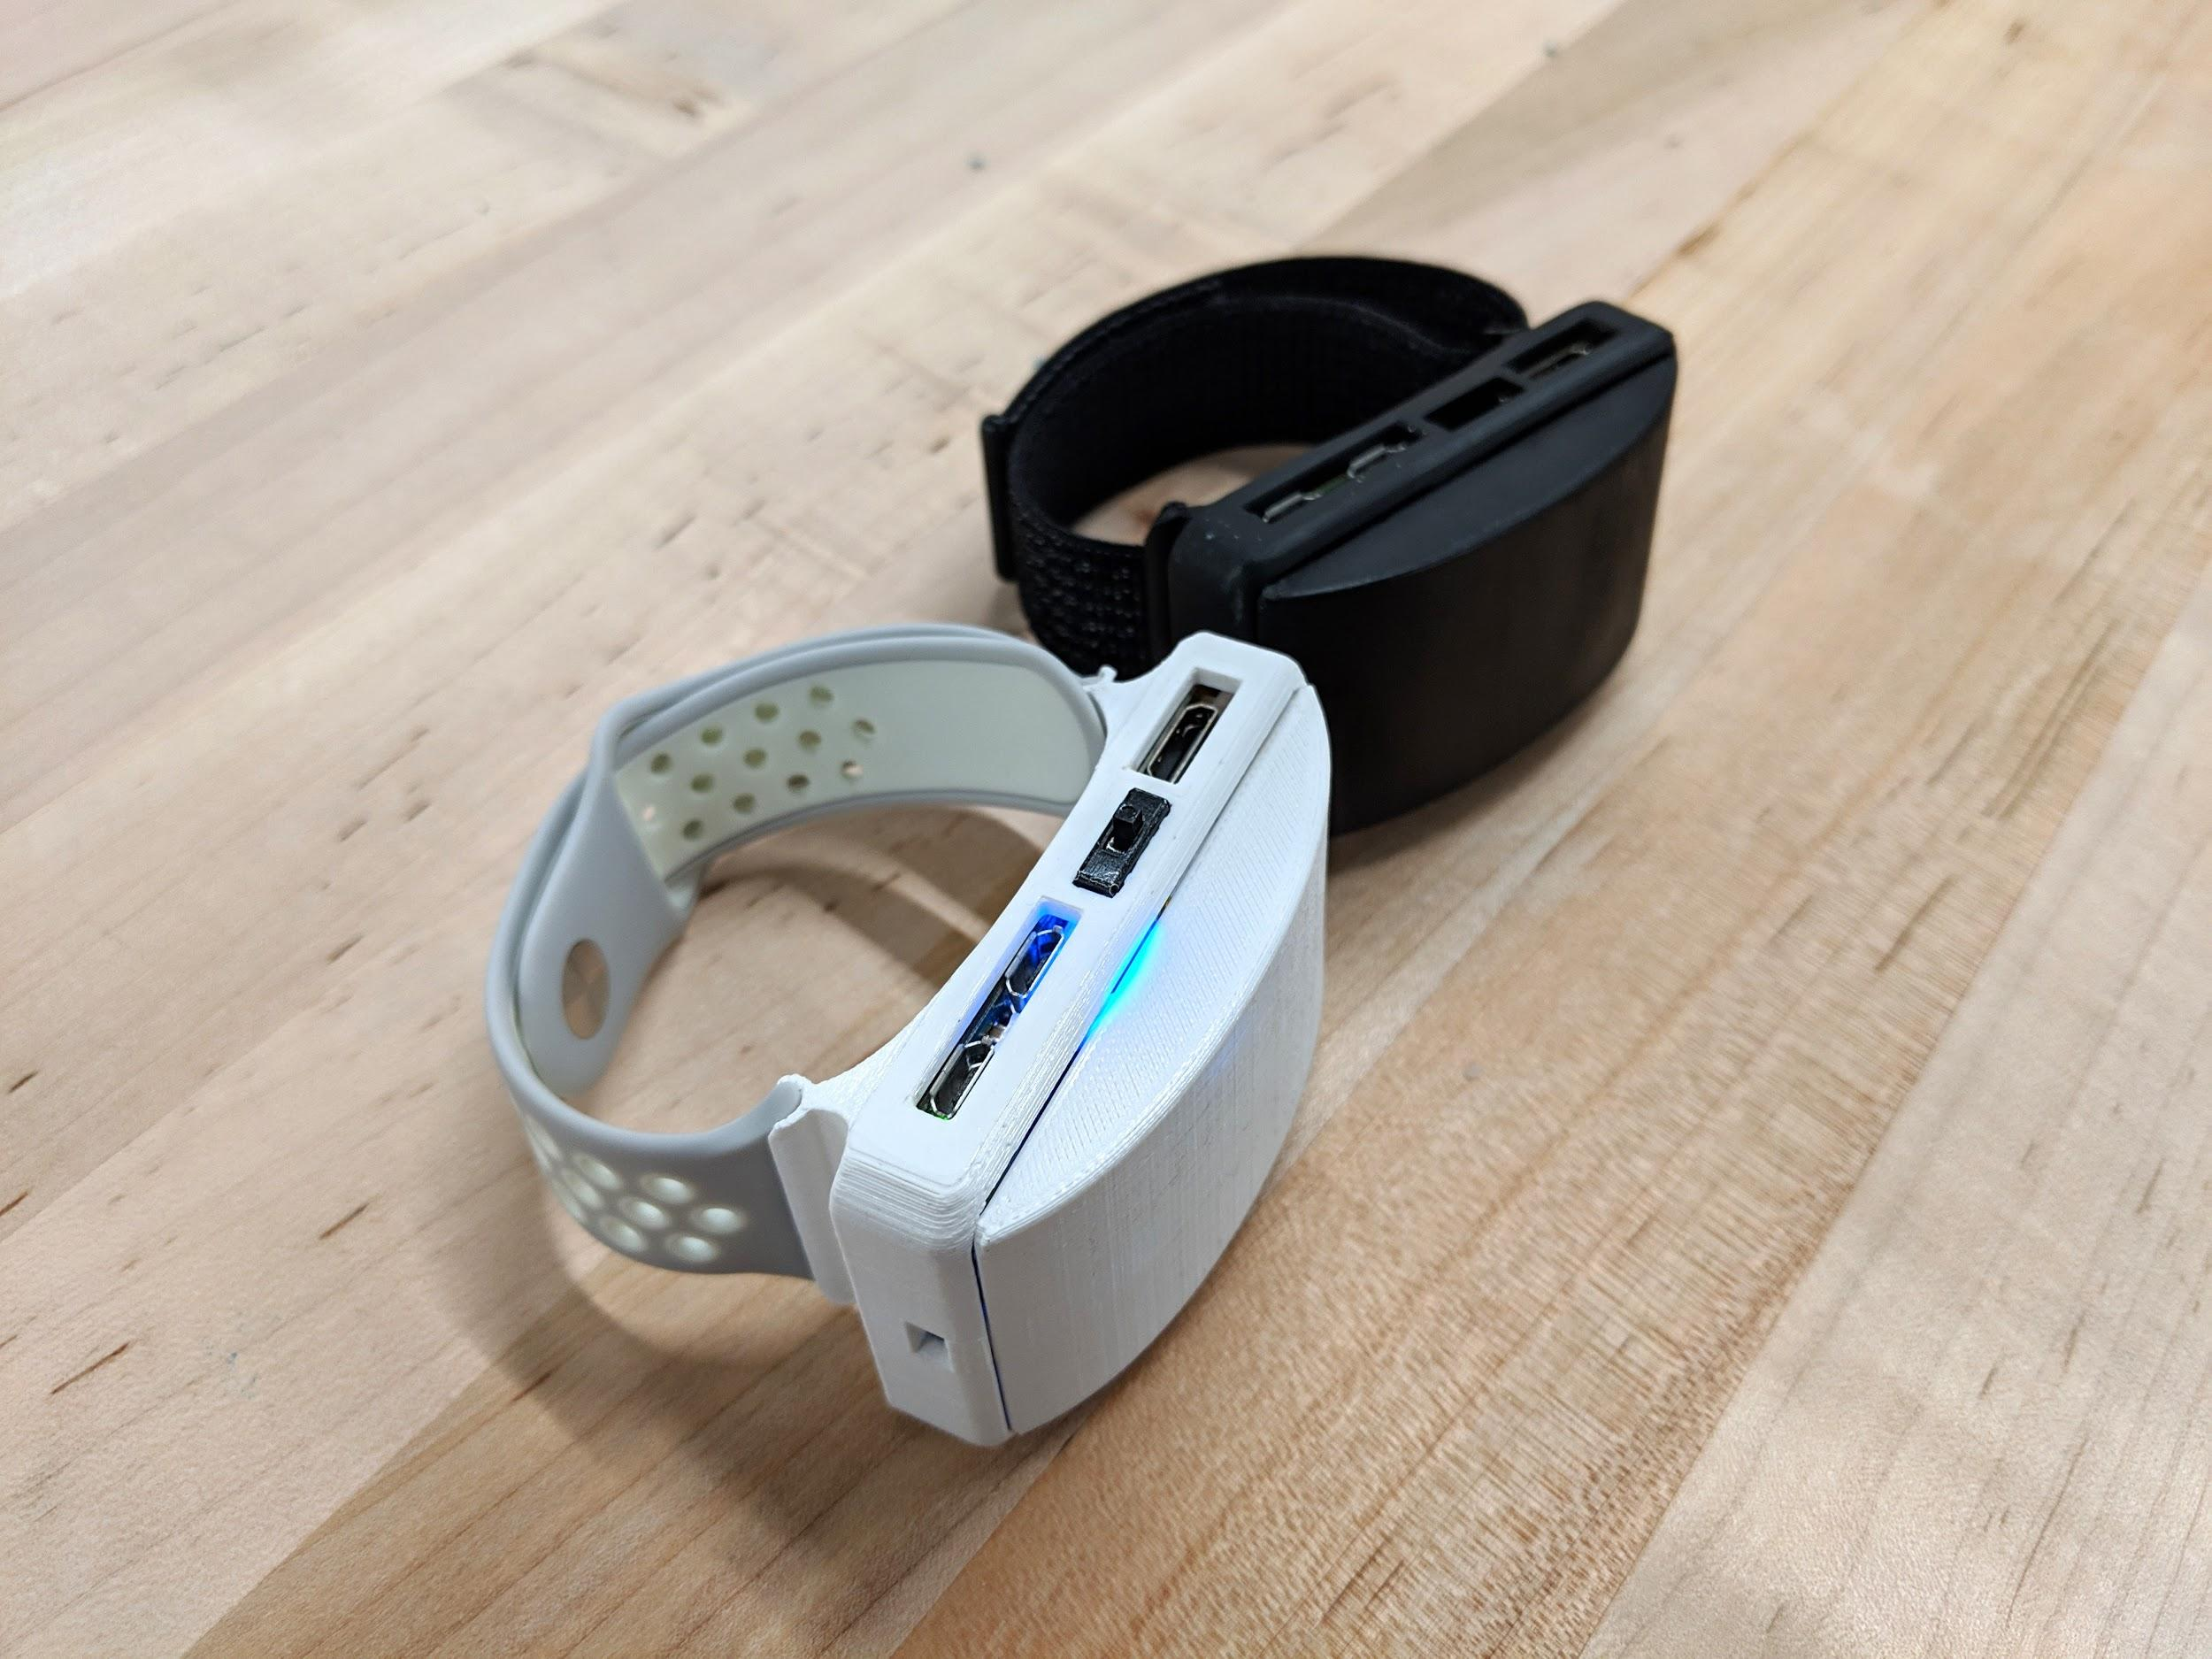
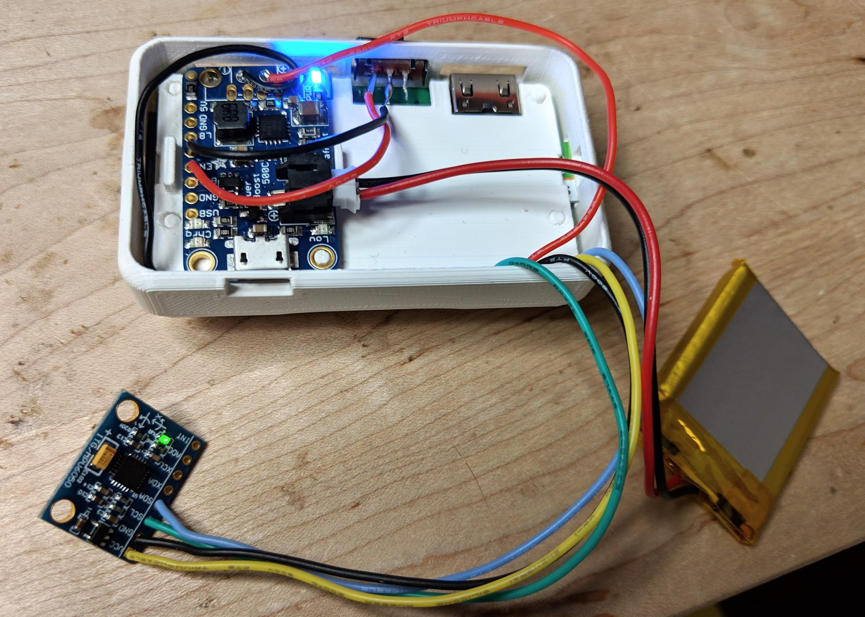
Hardware
Our design includes: Fully wireless, compact and comfortable watch style enclosure for our Raspberry pi 0 w, accelerometer, and a Powerboost 500C. Includes a rechargeable battery, and a switch to the control power.

Slide 5
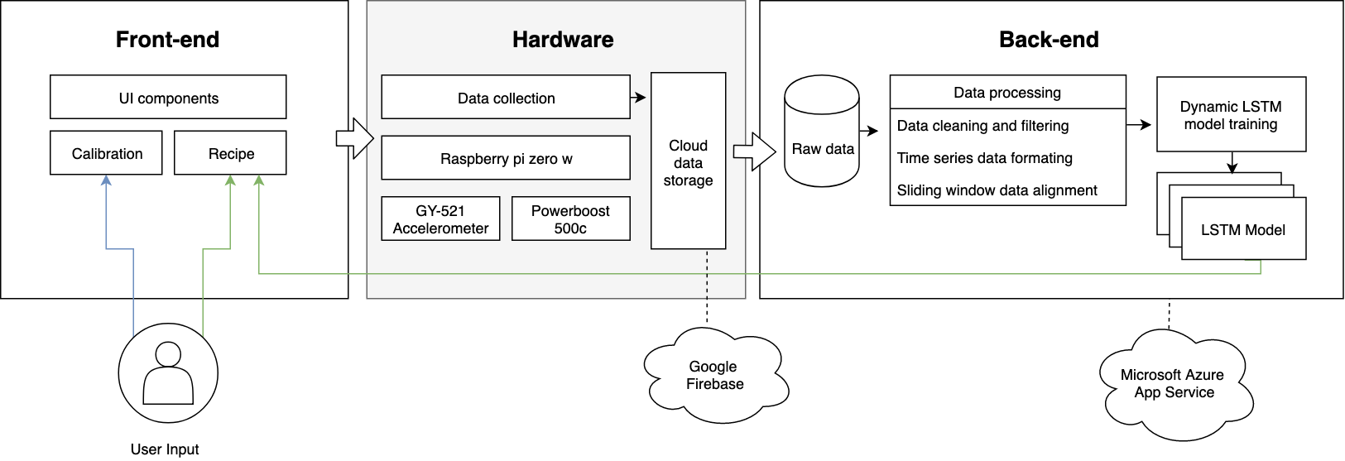
Software
Front end: Website interface that interacts with the user and displays new steps to the recipe as you complete different motions in your cooking. Automatically changes recipe steps while cooking based on detecting the motion.
Backend: Data collection and processing done on Raspberry Pi on the wrist watch, then fed to the Firebase database. We store our model on Azure, which is an LSTM model that can be repeatedly trained and can predict whenever the frontend wants a prediction.

Slide 6
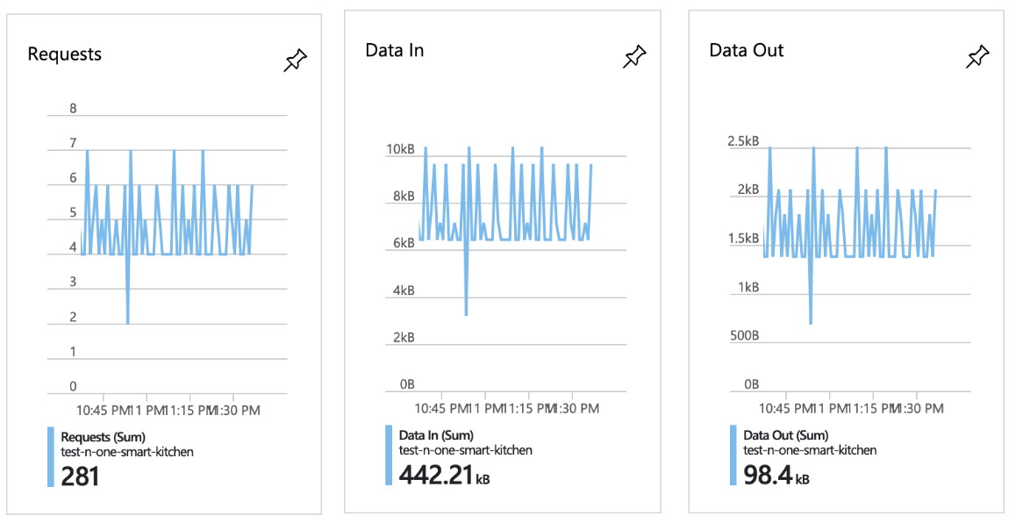

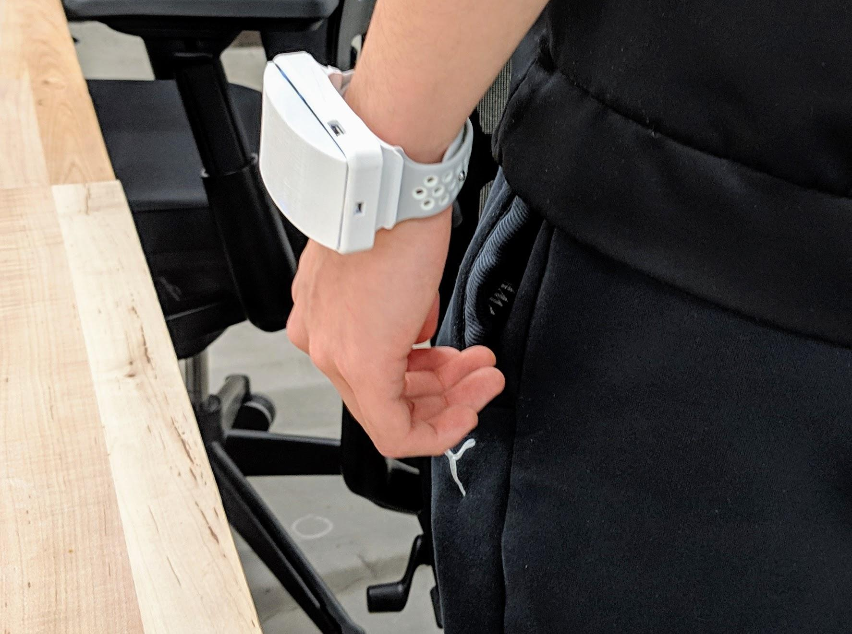
Delta from Milestone 2 to 3
Created full website interface that is controlled by the gestures and shows a recipe that the user can follow.
Implemented and organized full backend process for collecting data, transferring data to Firebase, preprocessing data in realtime, and training/predicting.
Pushed our models to Azure and run remotely on the cloud to speed up our training and prediction.
Changed wired watch design to wireless and rechargeable watch design.

Slide 7
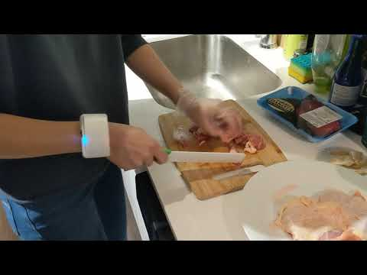
Prototype and Demo
3D printed enclosure for our Rpi zero which connects to a bracelet. Includes ports for battery charging, mini-HDMI display, and micro-USB. Clean and minimal design that is designed to be unobstructive to cooking.
https://www.youtube.com/watch?v=ggf3NXkmp50

Slide 8

Budget
Items | Unit Price | Quantity | Actual Spending
Raspberry pi 3 b+ kit | $79.99 | 1 | $79.99
Raspberry pi 0 w kit | $26.99 | 1 | $26.99
Total | $106.98
Future Spending | LCD monitor: $150 Bracelet strap: $30

